Slide 1
What do you notice in this picture?

Slide 2
If you look very carefully you may see a simple machine!
Have you spotted it yet? Look at the top of the screen.
What type of simple machine is shown here?

Slide 3
How are simple machines useful? Do they make less work for us?
NO!!
They DO NOT make LESS work, they just make work EASIER!
So what types of machines exist that make our lives easier? Do you know?
If so, take a moment and tell your neighbor what those machines are. And GO!

Slide 4
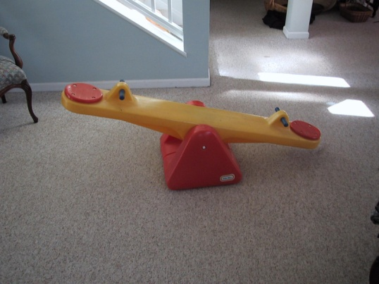
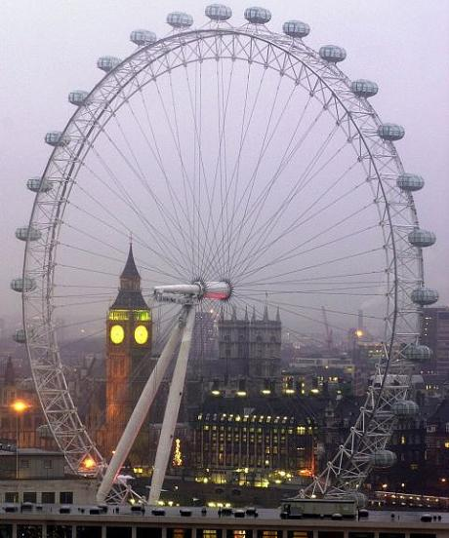
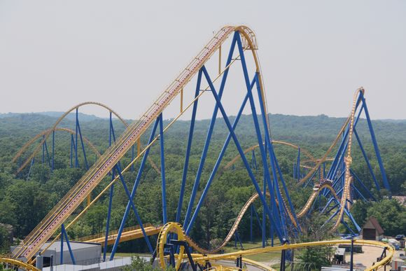
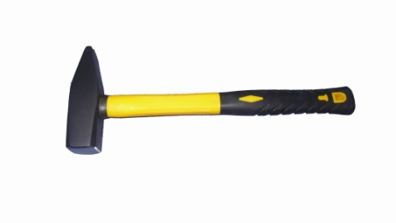
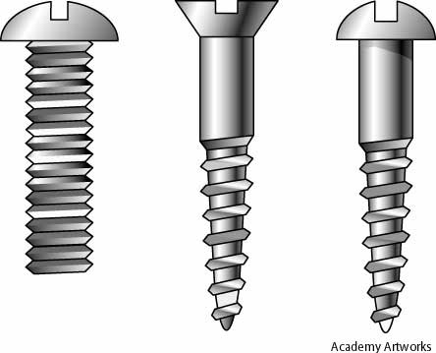
If you said any of the following you are RIGHT, so give your self a pat on the back!
LEVER
PULLEY
WHEEL & AXLE
INCLINED PLANE
WEDGE
SCREW

Slide 5
So let’s get more specific about these machines… First up, LEVERS.
Did you know there are 3, yes 3, types of levers?
Check out this short video to find out what they are and how they are different: Levers Video
Okay, now that you’ve seen the 3 types of levers, take a moment and illustrate each type in your notes.
And GO!
Your pictures should look something like the ones on page F22 in your science book – check it out to make sure you have the right idea.
And GO!

Slide 6
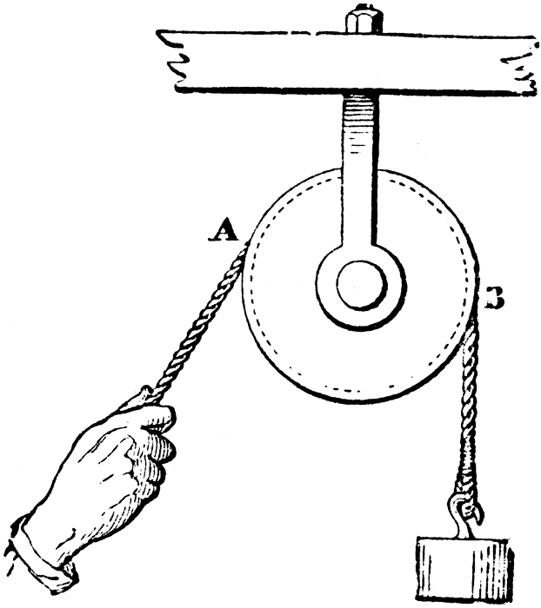
On to this machine – do you remember what it was called?
If you said PULLEY, you’re right, turn and give your neighbor a high five!
Fast Facts about PULLEYS:
There are 2 types – fixed & movable.
Pulleys decrease the effort force needed to lift a load.
Let’s check out page F24 for more information!

Slide 7
Next up…
A wheel & axel has TWO PARTS – the wheel and a bar that passes through the center of the wheel.
When force is applied to the wheel, like on a doorknob, it turns into a larger force from the axle . You have to turn the wheel a long way around for the axel to turn a short distance.
When you have a large wheel, like the Ferris wheel to the left, it will move farther and faster than the axle, this takes a lot of effort force.
Wheels & Axles

Slide 8
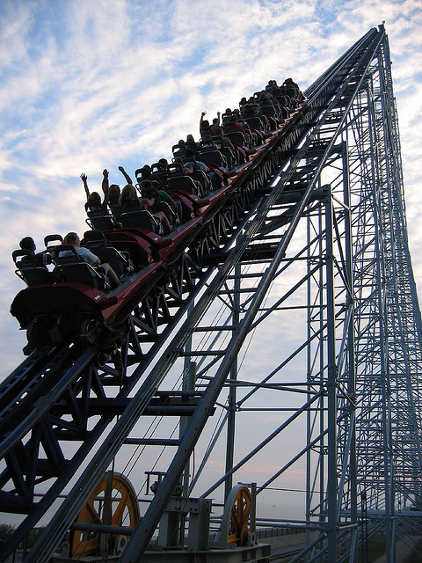
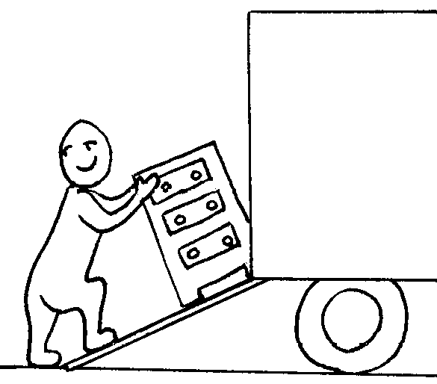
Up we go onto an Inclined Plane
Inclined = slanted Plane = flat
Some examples = a ramp, a long board slanting from the back of a truck, the first part of a roller coaster
Inclined planes – reduces the effort force needed to move an object

Slide 9
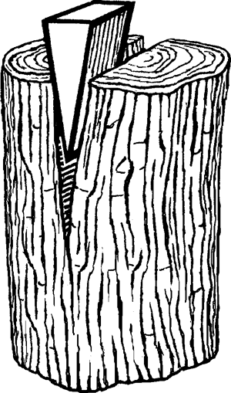
Winding on in to Screws & Wedges
What do you get if you put two inclined planes back to back?
Drum roll please…..A WEDGE
So what does a wedge do?
A wedge changes a downward or forward force into a sideways force.
Did you know that a screw is actually an inclined plane twisted into a spiral?
When you turn a screw, it will move forward and press on whatever is around it, like wood.
You need only a small force to move the screw.

